Slide 1
Bad News Letters
The Indirect Approach

Slide 2
What is a ‘bad news’ message?
A bad-news message is a letter, memo, or email that conveys negative or unpleasant information
information that is likely to disappoint, upset, or even anger a reader.
Also called an indirect message or a negative message.
Bad-news messages include rejections (in response to job applications, promotion requests, and the like)
negative evaluations
announcements of policy changes that don't benefit the reader.

Slide 3
The indirect plan/strategy
Intro the message with a positive/neutral buffer statement
Delve into the disappointing news – do not sugar coat this
Closing statement with recommendations/alternatives

Slide 4
The CRUCIAL introductory Paragraph
provide a buffer to cushion the bad news that will follow,
let the receiver know what the message is about without stating the obvious
serve as a transition into the discussion of reasons without revealing the bad news or leading the receiver to expect good news.
Carol M. Lehman and Debbie D Dufrene, Business Communication, 15th ed. Thomson, 2008

Slide 5
The body paragraph
Deliver the bad news in the body of the message.
State it clearly and concisely, and explain the reasons briefly and unemotionally.
Avoid apologies; they weaken your explanation or position.
Try to embed the bad news in a supporting, not the topical, sentence of a paragraph.
The purpose is not to conceal the bad news, but to soften its impact.
Stuart Carl Smith and Philip K. Piele, School Leadership: Handbook for Excellence in Student Learning. Corwin Press, 2006

Slide 6
The closing
The purpose of the closing is to maintain or rebuild good will.
Should be courteous and helpful.
Should have a sincere tone. Avoid overused closings such as If you have any questions, please don't hesitate to call. . . .
Offer the receiver another option. . . . Presenting another option shifts the emphasis from the negative news to a positive solution.
Thomas L. Means, Business Communications, 2nd ed. South-Western Educational, 2009)

Slide 7
Samples
On behalf of the members of the Research & Scholarship Committee, thank you for submitting an application for this year's Research & Scholarship grants competition.
I’m sorry to report that your grant proposal was among those that were not approved for funding in the spring. With the reduction in grant funds caused by budget cuts and the record number of applications, I’m afraid that many worthwhile proposals could not be supported.
Although you did not receive a grant this year, I trust that you will continue to pursue both internal and external funding opportunities.

Slide 8
Parts of the Negative News Message | Example
Buffer or Cushion | Thank you for your order. We appreciate your interest in our product.
Explanation | We are writing to let you know that this product has been unexpectedly popular, with over 10,000 requests on the day you placed your order.
Negative News | This unexpected increase in demand has resulted in a temporary out-of-stock/backorder situation. We will fulfill your order, received at 11:59 p.m. on 09/09/2009, in the order it was received.
Redirect | We anticipate that your product will ship next Monday. While you wait, we encourage you to consider using the enclosed $5 off coupon toward the purchase of any product in our catalog. We appreciate your business and want you to know that our highest priority is your satisfaction.

Slide 9
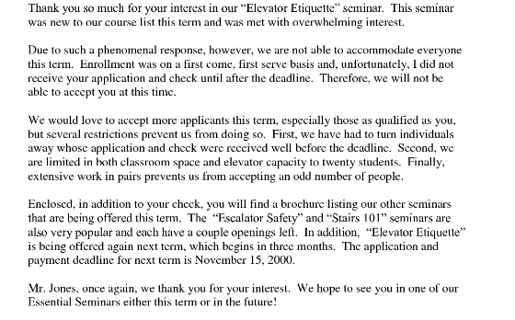

Slide 10
Class activity
Write ‘bad news’ letters to any of the following recipients;
a job applicant that was not hired
a vendor whose services you will no longer be using
a client who applied for credit with your company

